Slide 1
ASPLOS 2025
2025/7/14
Rotterdam, The Netherlands
Using Analytical Performance/Power Model and Fine-Grained DVFS to Enhance AI Accelerator Energy Efficiency
Zibo Wang¹, Yijia Zhang², Fuchun Wei³, Bingqiang Wang², Yanlin Liu³, Zhiheng Hu³, Jingyi Zhang³,
Xiaoxin Xu³, Jian He³, Xiaoliang Wang¹, Wanchun Dou¹, Guihai Chen¹, Chen Tian¹
¹Nanjing University ²Peng Cheng Laboratory ³Huawei

Slide 2
Introduction
Overview
Performance Model
Power Model
Strategy Generation
Evaluation
Conclusion
Outline

Slide 3
Introduction
Overview
Performance Model
Power Model
Strategy Generation
Evaluation
Conclusion
Outline

Slide 4
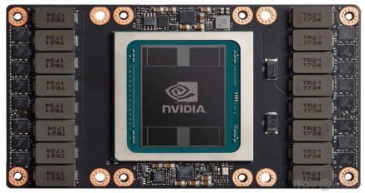
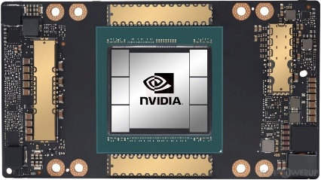
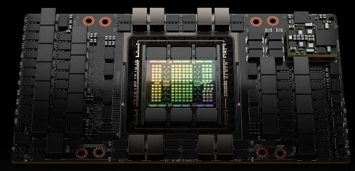
Introduction
Thermal Design Power(TDP) of AI Accelerators increases quickly.
V100
300 W
A100
400 W
H100
700 W
B100
~1000 W
Reducing energy consumption is necessary!
Power usage of AI systems worldwide incurring high costs.
“Nvidia Sells over 1,500,000 H100 GPUs in 2024” from recent news
---equivalent to $1,200 million energy cost per year (if running at peak power)

Slide 5
Introduction
Dynamic Voltage and Frequency Scaling (DVFS) is a main power control mechanism.
V↓ f↓ → Power↓ → Performance↓
V↑ f↑ → Power↑ → Performance↑
DVFS-based energy optimization for AI accelerators has been explored in many studies
Limitation: Previous works apply DVFS at course granularity due to long DVFS latency(~15ms).
Opportunity:
Performance impacts of DVFS vary across operators (Compute-bound👎🏻 Memory-bound👍🏻)
Ascend NPU allows frequency adjustments for individual or multiple operators(~1ms).
Challenge: To set a frequency for every operator, search space is very large(>10k).
Our Goal:
To improve energy efficiency while keeping performance bounded!

Slide 6
Introduction
Overview
Performance Model
Power Model
Strategy Generation
Evaluation
Conclusion
Outline

Slide 7
Overview
Performance Model: Operator cycle consumption follows a piecewise linear, convex function with AICore frequency.
Perf. Model Construction
Estimated
Exec. Time
Estimated Energy
Generate
DVFS strategy
DVFS strategy
Execute
Workload
Profiling Data
Power Model Construction
Estimated Power

Slide 8
Overview
Performance Model: Operator cycle consumption follows a piecewise linear, convex function with AICore frequency.
Power Model: We incorporate the temperature factor often ignored by other works, improving the model's accuracy.
Perf. Model Construction
Estimated
Exec. Time
Estimated Energy
Generate
DVFS strategy
DVFS strategy
Execute
Workload
Profiling Data
Power Model Construction
Estimated Power

Slide 9
Overview
Performance Model: Operator cycle consumption follows a piecewise linear, convex function with AICore frequency.
Power Model: We incorporate the temperature factor often ignored by other works, improving the model's accuracy.
Fine-Grained Frequency Control: By integrating operator classification, preprocessing, and a genetic algorithm-based search, we effectively reduce the search space and accelerate strategy optimization.
Perf. Model Construction
Estimated
Exec. Time
Estimated Energy
Generate
DVFS strategy
DVFS strategy
Execute
Workload
Profiling Data
Power Model Construction
Estimated Power

Slide 10
Introduction
Overview
Performance Model
Power Model
Strategy Generation
Evaluation
Conclusion
Outline

Slide 11
Performance Model
The memory hierarchy our performance model relys on:
An L1 cache in each AICore
A shared L2 cache and High Bandwidth Memory (HBM)
Operating on different frequency domain
AICore/SM
Compute Unit
Core Domain
L1Cache
L2Cache
Uncore Domain
HBM

Slide 12
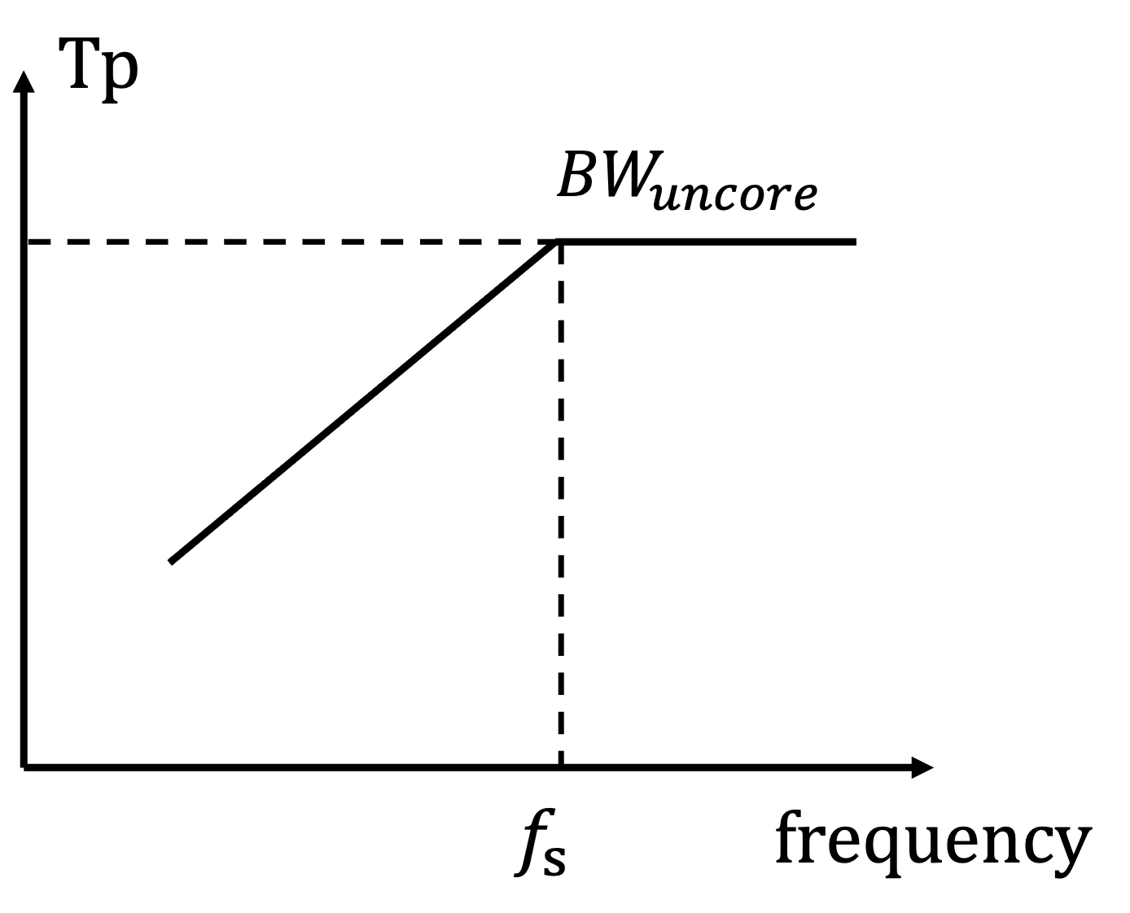
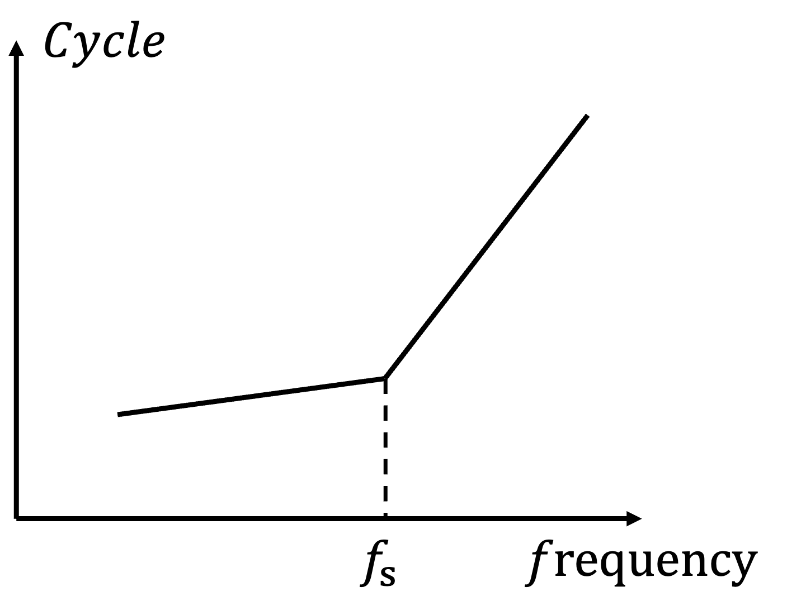
Performance Model
Load/Store Bandwidth Analysis.
Throughput (𝑇𝑝) of Ld/St is influenced by both the core frequency (𝑓) and the uncore bandwidth limitations:
$$Tp\left(f\right)=min\left(C × f × core_{num} , BW_{uncore} \right)$$
Assuming 𝑀 is the Ld/St data transfer volume and 𝑇 is its execution time:
$$T=\frac{M}{Tp\left(f\right)} +{ \underset{ }{\underbrace{T_{0}}}}_{ } \\ Fixed Time Overhead \\ Cycle\left(f\right)=T×f \\ =\max\left(\frac{M}{BW_{uncore}}f,\frac{M}{C×core_{num}}\right)+T_{0}f \\ =max\left(af,c\right)+T_{0}f$$

Slide 13
Performance Model
PingPong(Double Buffering)-Free and Independent Ld/St Scenarios.
$$max\left(Cycle\left(Ld\right),Cycle\left(St\right)\right)=Cycle(Ld)$$
$$max\left(Cycle\left(Ld\right),Cycle\left(St\right)\right)=Cycle(St)$$
$$Cycle\left(f\right)=$$
$$Cycle\left(Ld\right)$$

Slide 14
Performance Model
PingPong(Double Buffering)-Free and Independent Ld/St Scenarios.
$$max\left(Cycle\left(Ld\right),Cycle\left(St\right)\right)=Cycle(Ld)$$
$$max\left(Cycle\left(Ld\right),Cycle\left(St\right)\right)=Cycle(St)$$
$$Cycle\left(f\right)=$$
$$Cycle\left(Ld\right)$$
$$+Cycle\left(St\right)$$

Slide 15
Performance Model
PingPong(Double Buffering)-Free and Independent Ld/St Scenarios.
$$max\left(Cycle\left(Ld\right),Cycle\left(St\right)\right)=Cycle(Ld)$$
$$max\left(Cycle\left(Ld\right),Cycle\left(St\right)\right)=Cycle(St)$$
$$Cycle\left(f\right)=$$
$$Cycle\left(Ld\right)$$
$$+Cycle\left(St\right)$$
$$+n×Cycle\left(core\right)+(n−1)×max⁡(Cycle\left(Ld\right),Cycle\left(St\right))$$

Slide 16
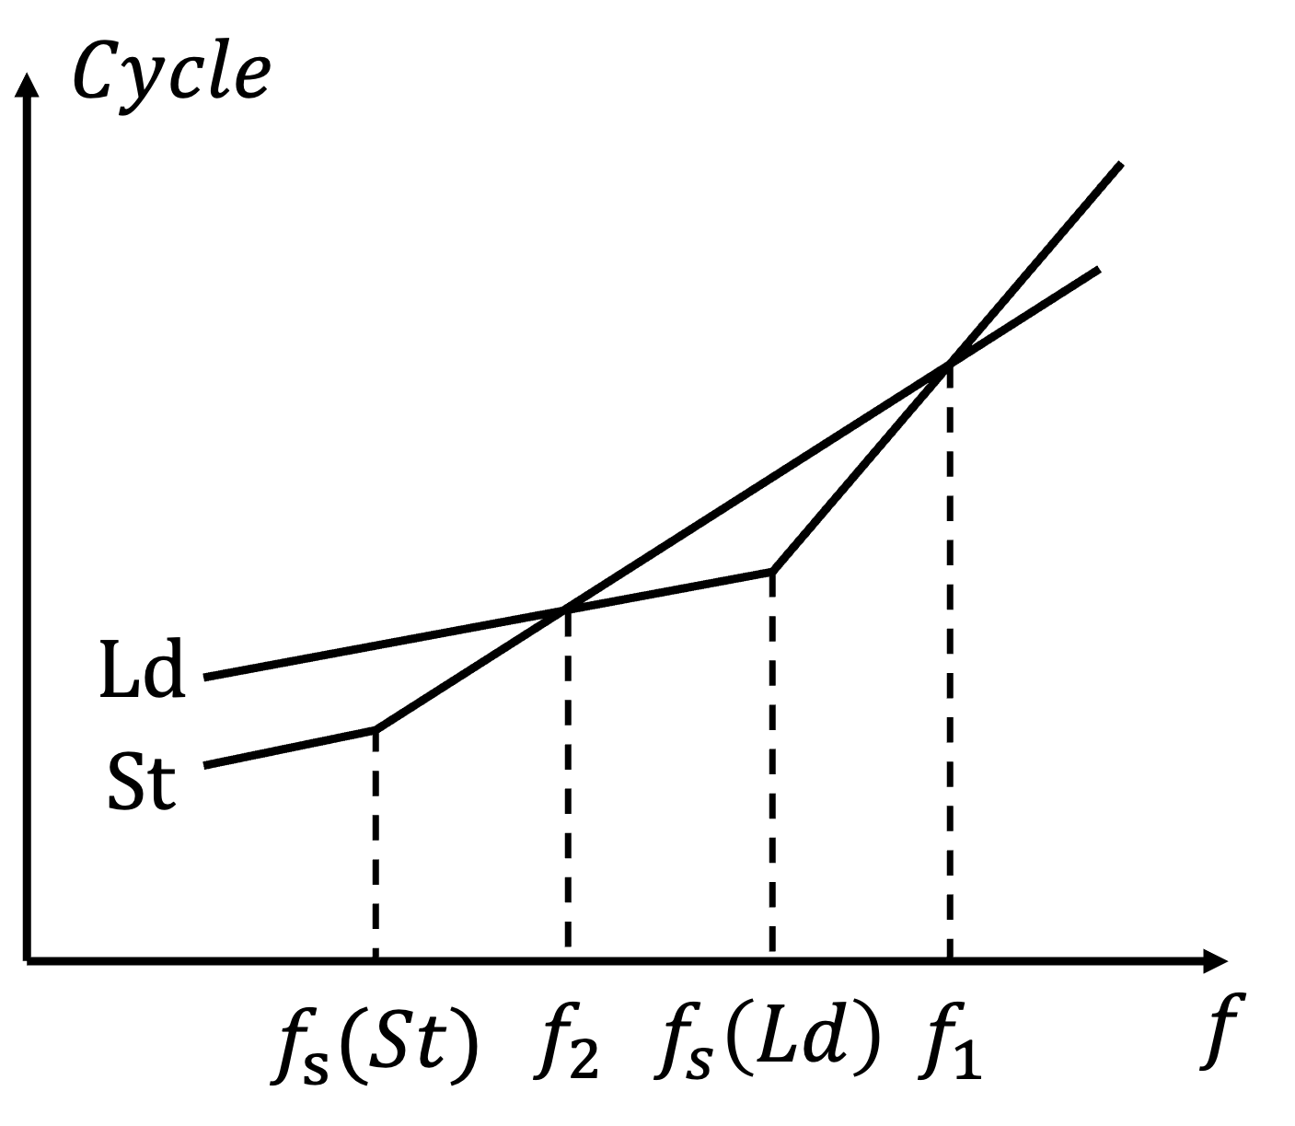
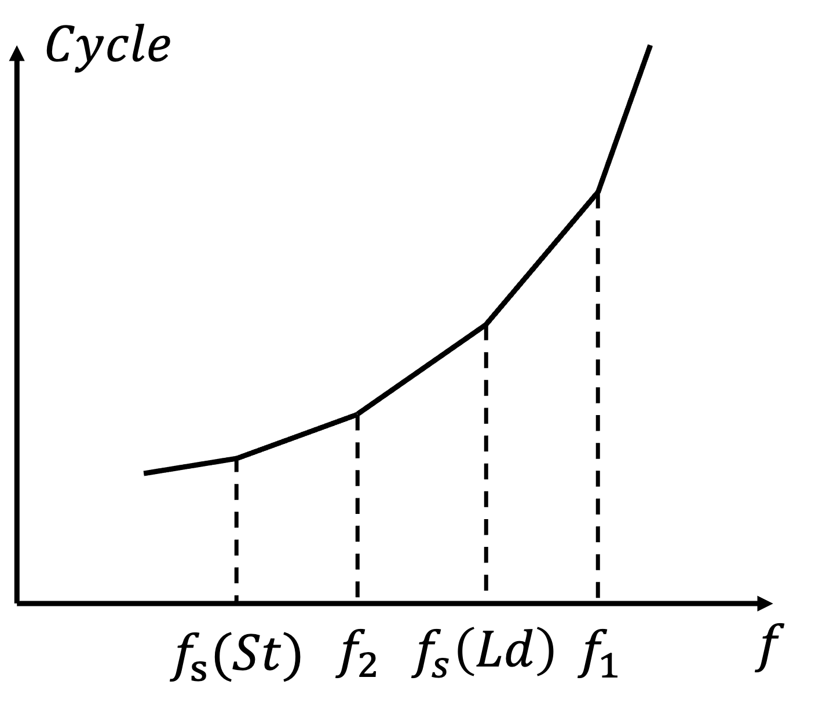
Performance Model
PingPong(Double Buffering)-Free and Independent Ld/St Scenarios.
$$Cycle\left(f\right)=Cycle\left(Ld\right)+Cycle\left(St\right)+n×Cycle\left(core\right) \\ +(n−1)×max⁡(Cycle\left(Ld\right),Cycle(St) \\ =max\left(a_{1}f,c_{1}\right)+max\left(a_{2}f,c_{2}\right)+n×Cycle\left(core\right) \\ +\left(n−1\right)×max\left(a_{1}f,c_{1},a_{2}f,c_{2}\right)+(n+1)×T_{0}f$$
$$a_{1}>a_{2}>0$$
$$k_{1}=(n+1)×T_{0}$$
$$k_{2}=a_{2}+(n+1)×T_{0}>k_{1}$$
$$k_{3}={n×a}_{2}+(n+1)×T_{0}>k_{2}$$
$$k_{4}={a_{1}+n×a}_{2}+(n+1)×T_{0}>k_{3}$$
$$k_{5}={n×a_{1}+a}_{2}+(n+1)×T_{0}>k_{4}$$

Slide 17
Summary of Performance Model
$$Cycle\left(f\right)=max\left(a_{1}f,c_{1}\right)+max\left(a_{2}f,c_{2}\right)+n×Cycle\left(core\right)+\left(n−1\right)×max\left(a_{1}f,c_{1},a_{2}f,c_{2}\right)+\left(n+1\right)×T_{0}f$$
Insight:
The cycle count of an operator can be modeled as a convex piecewise linear function of frequency.
Challenge:
Unable to determine the breakpoints of the piecewise linear function.
Each data point requires a profiling process, so it is essential to minimize the amount of data needed for modeling to reduce the number of profiling runs.
Solution:
Employ commonly used concave function $Cycle\left(f\right)=af^{2}+c$ to fit the operator performance data.

Slide 18
Introduction
Overview
Performance Model
Power Model
Strategy Generation
Evaluation
Conclusion
Outline

Slide 19
Power Model
The dynamic power encompasses load-dependent power and load-independent power.
The static power can be decomposed into subthreshold leakage current and gate oxide current. Among them, the subthreshold leakage current can be considered to be linearly correlated with temperature ($I_{sub}=γT+C$).
The hardware power consumption consists of dynamic power and static power.
$$P_{dyn} =\underset{ }{\underbrace{αfV^{2}}} + \underset{ }{\underbrace{βfV^{2}}} \\ load−dependent load−independent$$
$$P_{static}=\left(I_{sub}+I_{gate}\right)V \\ =\left(γT+C+I_{gate}\right)V \\ =γΔT+\left(γT_{0}+C+I_{gate}\right)V$$
$$P=P_{dyn}+P_{static} \\ =αfV^{2}+\underset{ }{\underbrace{βfV^{2}+θV}}+\underset{ }{\underbrace{γVΔT}} \\ P_{idle} P_{ΔT}$$

Slide 20
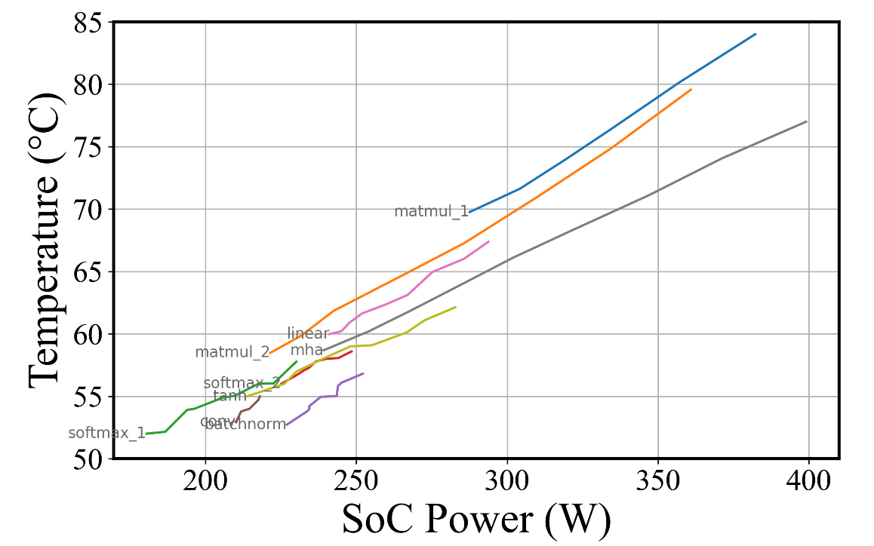
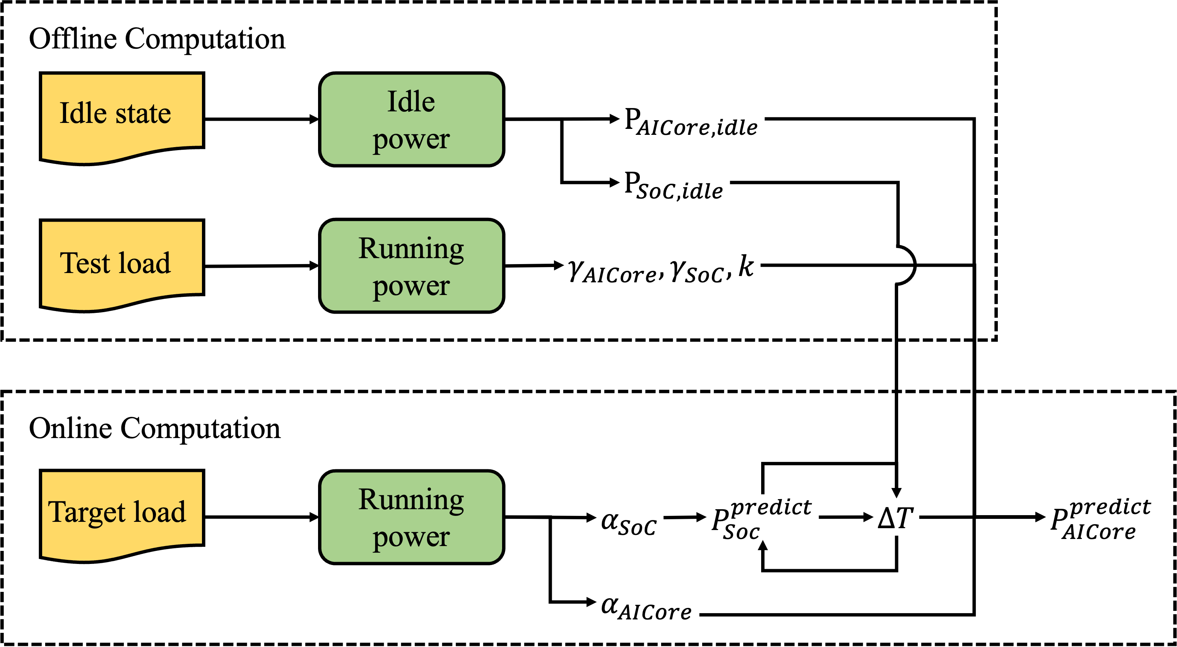
Power Model
Experiments reveal a linear correlation between AICore temperature 𝑇 and SoC power
Finally, we construct the power model through offline and online computation.
$$ΔT=kP_{SoC}$$
Relationship Between Temperature and SoC Power.
The Construction of a power model.

Slide 21
Introduction
Overview
Performance Model
Power Model
Strategy Generation
Evaluation
Conclusion
Outline

Slide 22
Strategy Generation
Challenge:
When reducing energy consumption, minimizing performance loss is important
To set a frequency for each operator, search space is very large (>10k)
Solution:
Operator classification
Preprocessing and frequency point merging
Genetic algorithm-based search

Slide 23
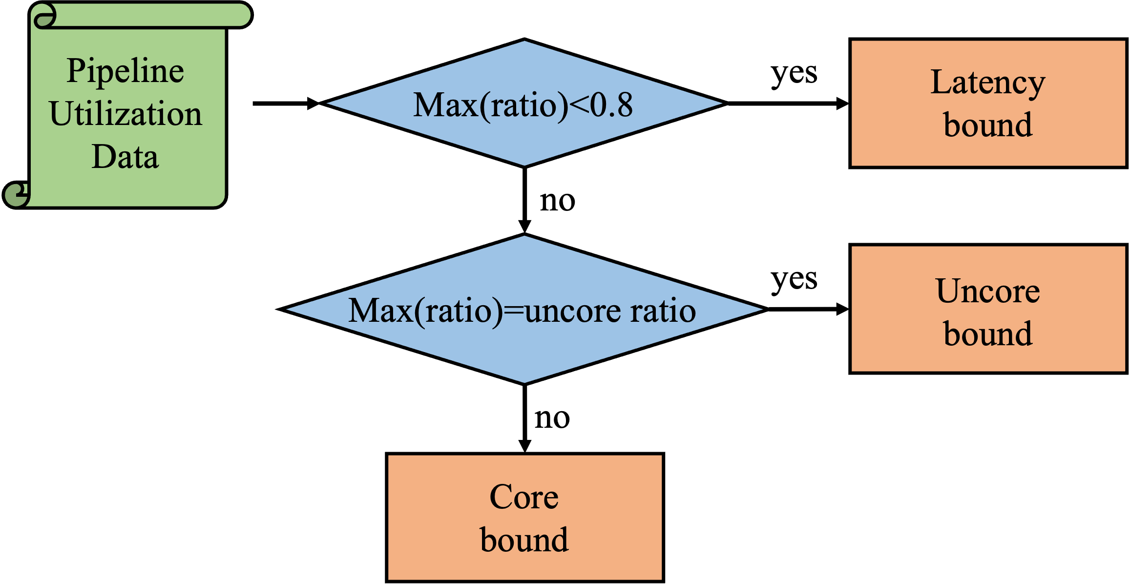
Strategy Generation
Operator classification: We categorize operators into two types: those sensitive to AICore frequency and those insensitive.
AICore Frequency-Sensitive Operators | Core-Bound, Latency-Bound operators
AICore Frequency-Insensitive Operators | Uncore-Bound, AICPU, communication operators and idle
Classification of operators based on their sensitivity to AICore frequency.

Slide 24
Strategy Generation
Preprocessing:
Gather the execution sequence and profiling data of operators
Analyse the bottleneck types
Devide the execution process into Low Frequency Candidate (LFC) and High Frequency Candidate (HFC)
Merge candidates with intervals shorter than a threshold with adjacent candidates
Illustrations of each preprocessing step.

Slide 25
Strategy Generation
Using a genetic algorithm to search for different NPU operating frequency combinations to obtain the optimal energy-efficient configuration.
$$f=?$$
$$f=?$$
$$f=?$$
$$f=?$$
$$f=?$$
$$⋯$$
Generation N, Individual 1
Generation N+1, Individual 1
$$f_{1,1}$$
$$f_{1,2}$$
$$f_{1,3}$$
$$f_{1,4}$$
$$f_{1,5}$$
Mutation
$${f′}_{1,1}$$
$${f′}_{1,2}$$
$${f′}_{1,3}$$
$${f′}_{1,4}$$
$${f′}_{1,5}$$
Generation N, Individual 2
Generation N+1, Individual 1
$$f_{2,1}$$
$$f_{2,2}$$
$$f_{2,3}$$
$$f_{2,4}$$
$$f_{2,5}$$
$${f′}_{2,1}$$
$${f′}_{2,2}$$
$${f′}_{2,3}$$
$${f′}_{2,4}$$
$${f′}_{2,5}$$
Crossover
Generation N, Individual 3
Generation N+1, Individual 1
$$f_{3,1}$$
$$f_{3,2}$$
$$f_{3,3}$$
$$f_{3,4}$$
$$f_{3,5}$$
$${f′}_{3,1}$$
$${f′}_{3,2}$$
$${f′}_{3,3}$$
$${f′}_{3,4}$$
$${f′}_{3,5}$$

Slide 26
Introduction
Overview
Performance Model
Power Model
Strategy Generation
Evaluation
Conclusion
Outline

Slide 27
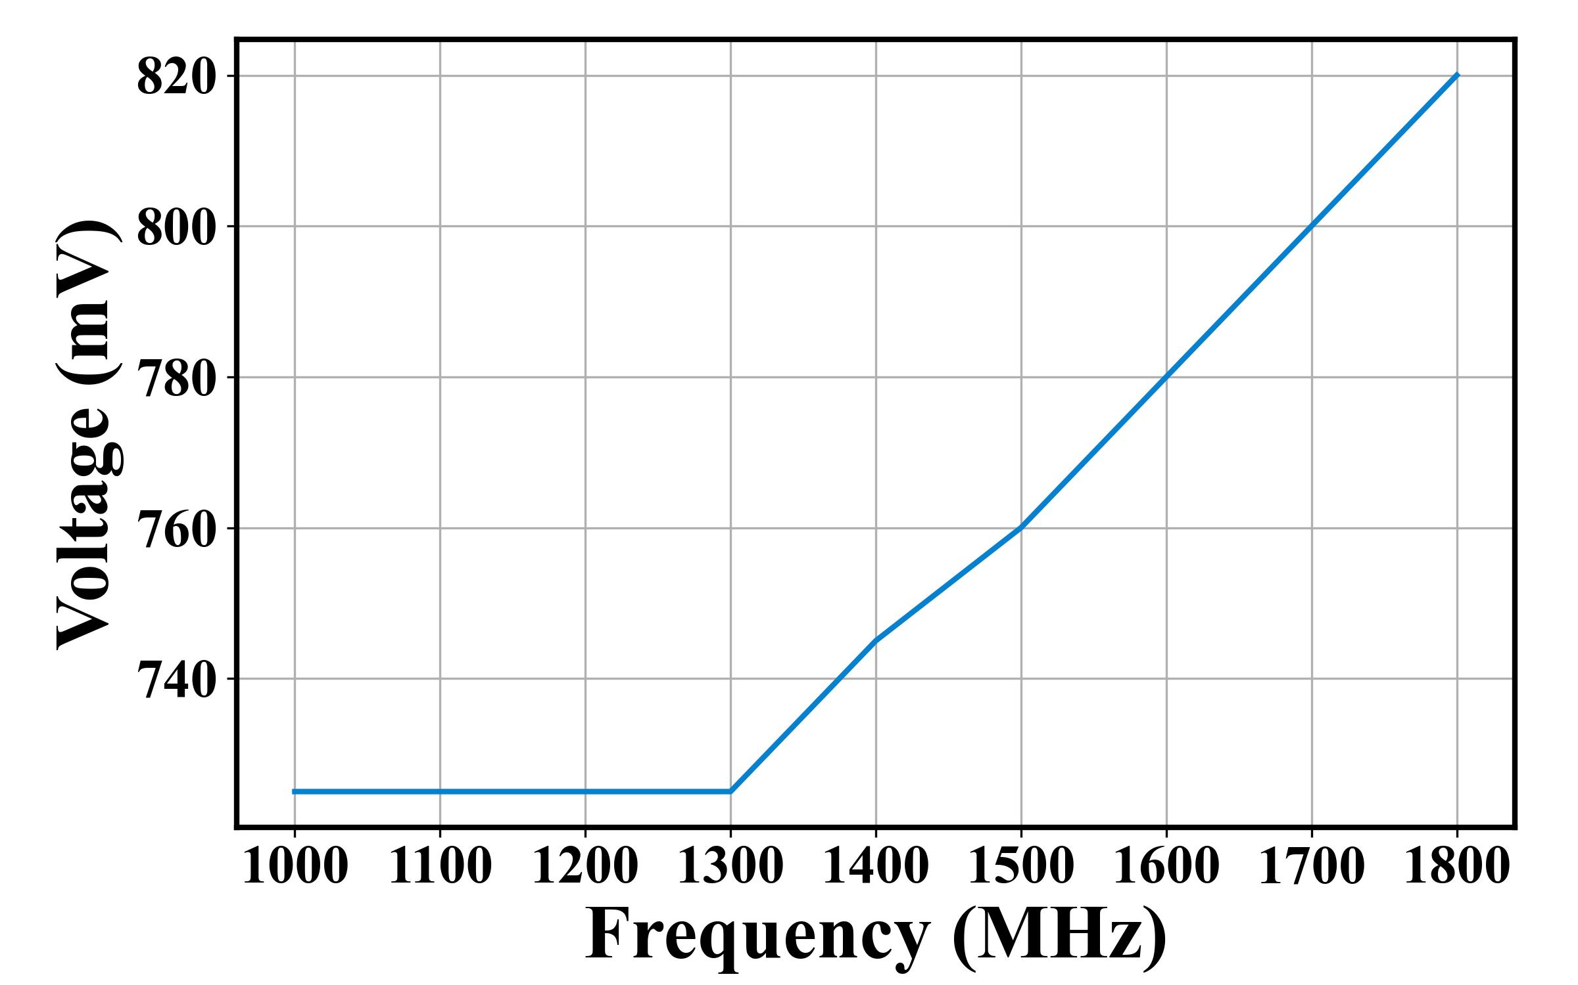
Evaluation
Testbed Introduction:
The Ascend NPU allows frequency adjustment with automatic voltage adaptation by its firmware.
It supports frequencies ranging from 1000MHz to 1800MHz in 100MHz increments.
Huawei Ascend
Voltage-Frequency on Ascend NPU

Slide 28
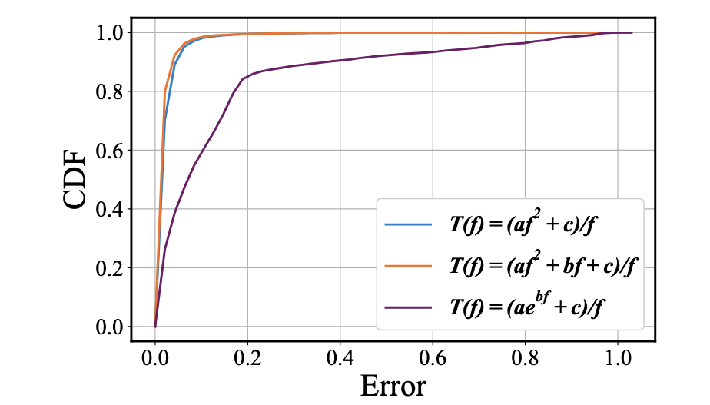
Evaluation
Performance Model:
Workload: Over 5,000 operators across 6 frequency points, totaling over 30,000 data points.
We compare three different functions for fitting.
The one we use for fitting achieves an average prediction error of just 1.96%.
Error of predicted results of our Performance model

Slide 29
Evaluation
Performance Model:
Workload: the training of GPT3, Bert, VGG19, ResNet50, ViT models, and Softmax and Tanh operators.
The model achieves an average prediction error of just 4.62% across multiple common workloads.
Error of predicted results of our power model

Slide 30
Evaluation
Fine-Grained Frequency Scaling :
Workload: the training of GPT3, Bert, ResNet50 and ResNet152 with different performance loss target.
With a 2% performance loss target, an average performance loss of 1.76% achieves a 13.44% reduction in AICore energy consumption.
End-to-End Experimental Results

Slide 31
Introduction
Overview
Performance Model
Power Model
Strategy Generation
Evaluation
Conclusion
Outline

Slide 32
Conclusion
We optimize the end-to-end process of model training for energy efficiency.
We construct a white-box performance model with an average error of 1.96%.
We construct a power model incorporating a temperature-dependent factor, with an average error of 4.62%.
We propose a DVFS strategy for accelerators supporting millisecond-level DVFS control. Experiments demonstrate a reduction in AICore power by 13.44%, while limiting performance degradation to 1.76%.

Slide 33
ASPLOS 2025
2025/7/14
Rotterdam, The Netherlands
Thank you!
wangzb@smail.nju.edu.cn

