Slide 1





Accelerating Model Training on Ascend Chips: An
Industrial System for Profiling, Analysis and Optimization
Yuhang Zhou¹, Zibo Wang¹, Zhibin Wang¹, Ruyi Zhang¹, Chen Tian¹, Xiaoliang Wang¹, Wanchun Dou¹, Guihai Chen¹,
Bingqiang Wang², Yonghong Tian², Yan Zhang², Hui Wang², Fuchun Wei³, Boquan Sun³, Jingyi Zhang³,
Bin She³, Teng Su³, Yifan Yao³, Chunsheng Li³, Ziyang Zhang³, Yaoyuan Wang³, Bin Zhou⁴, Guyue Liu⁵
¹ Nanjing University ² Peng Cheng Laboratory ³ Huawei ⁴ Shandong University ⁵ Peking University

Slide 2





Outline
Introduction
Insights
System Design
Case Study
Conclusion

Slide 3




Outline
Introduction
Insights
System Design
Case Study
Conclusion

Slide 4






Different Roles in Model Training
Optimization library
Developer
Parallel
I/O
Computation
Communication
Model
Hardware
Deployer
Maintainer
Running
4

Slide 5

Developer
Optimization library
Parallel
I/O
DP/PP/TP/SP
Auto Parallel: Alpa, …
CPU processing: Pecan, …
Cache strategy: UGACHE, …
Data prefetch: Fastensor, …
Computation
Communication
Operator fusion: T3, …
Memory management: GMLake, …
Compiler：Cocktailer, …
Scheduler: Syndicate, …
Topology：TopoOpt, …
Collectives：TCCL, …
Identify bottlenecks and develop optimizations
5

Slide 6
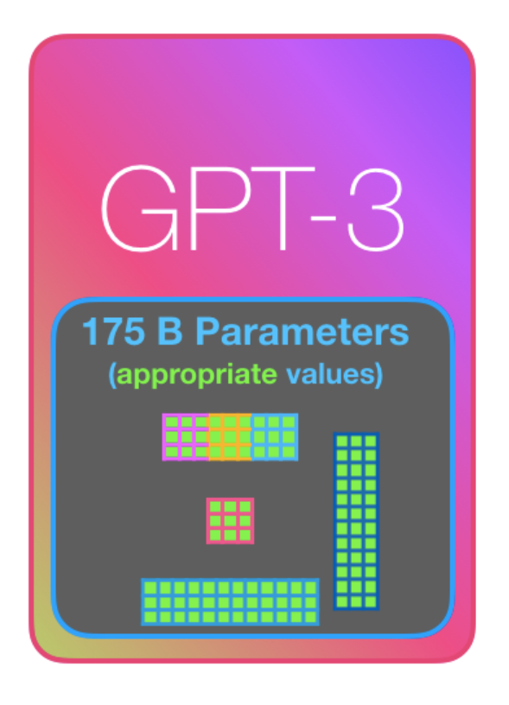
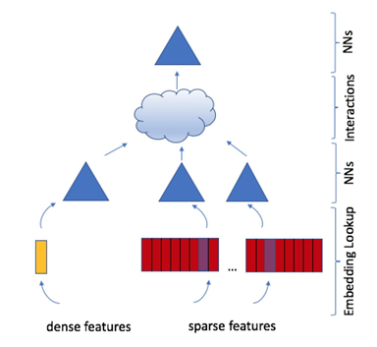
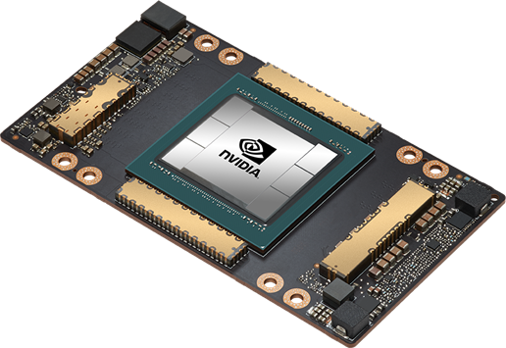
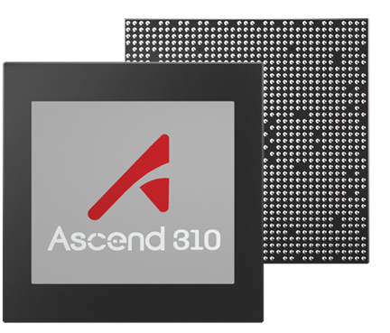
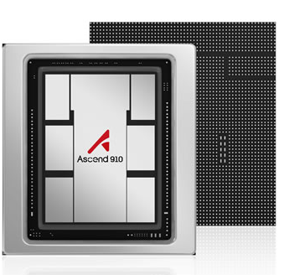
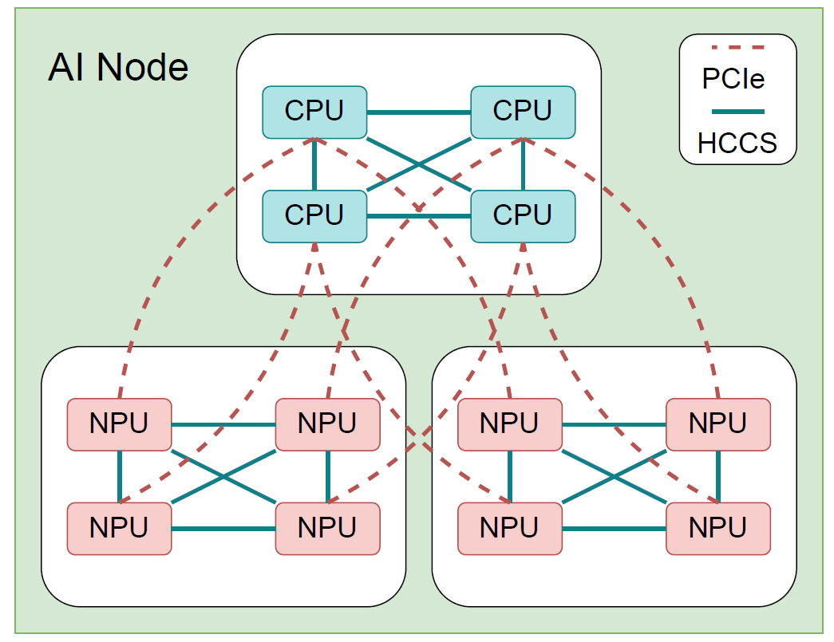
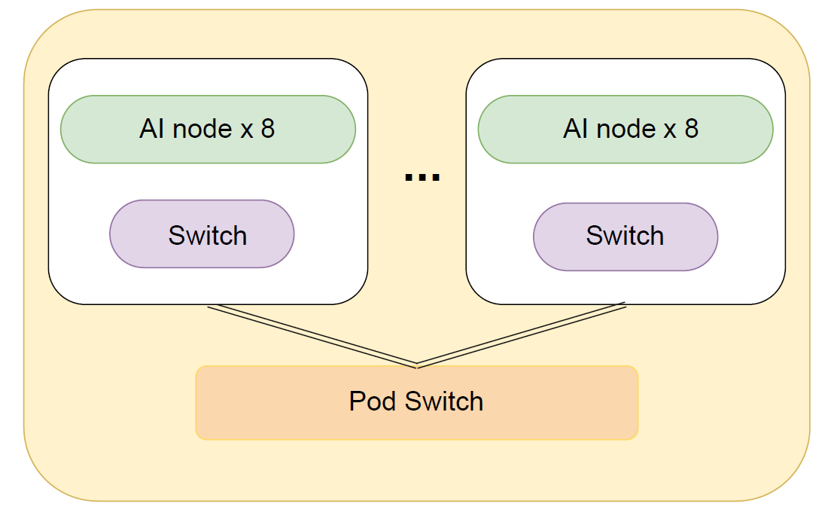
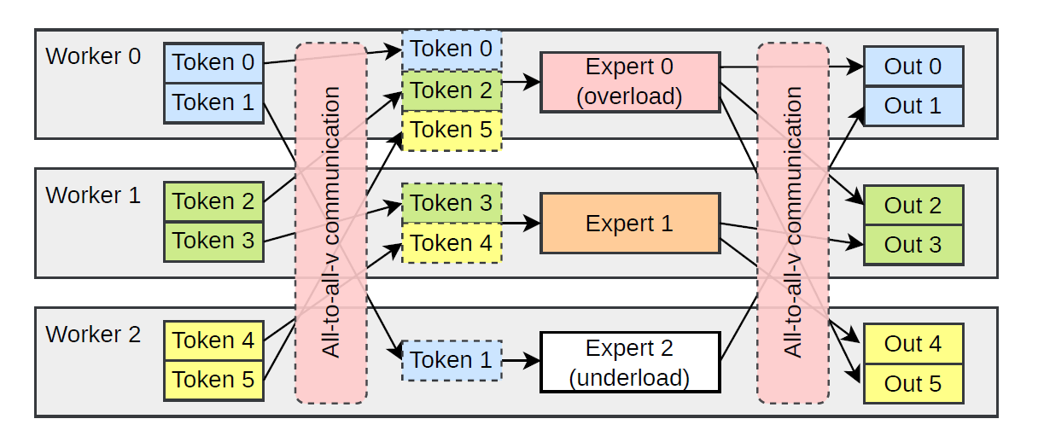
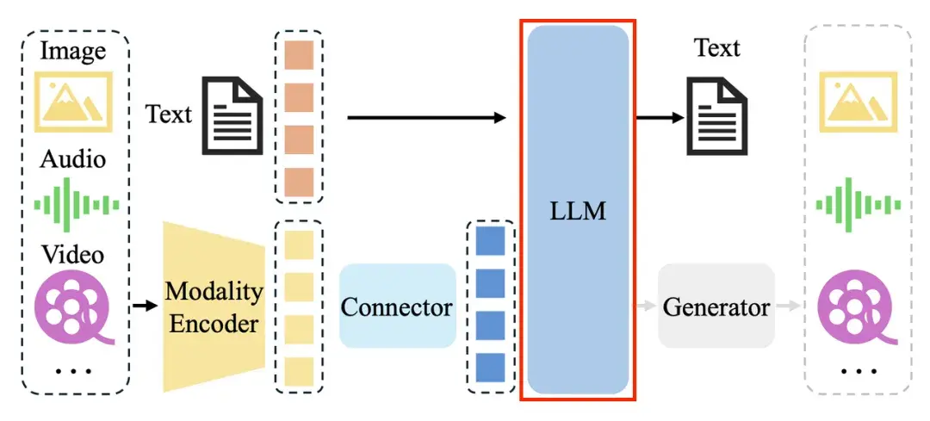
Deployer
Model
Hardware
GPU vs NPU
Transformer
DLRM
MoE
Multimodal
Single node vs Multi node
Select optimization for varying models and hardware
6

Slide 7
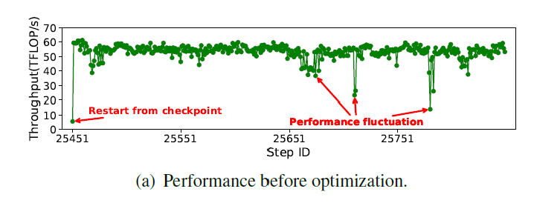

Maintainer
Random and unpredictable performance fluctuations
Report
Real-time monitoring to capture performance fluctuations
7

Slide 8
Different Roles in Model Training
Goals
Optimization library
Developer
Parallel
I/O
Bottleneck identification
Computation
Communication
Model
Hardware
Optimization selection
Deployer
Maintainer
Running
Real-time
monitor
8

Slide 9
Limitations
Profiling
Analysis
Optimization
Bottleneck identification
Fine-grained profiling
Comprehensive analysis
Optimization
guidance
Optimization selection
Continuous profiling
Real-time
monitor
Limitations
High profiling overhead
Partial bottleneck analysis
Limited
optimization scope

Slide 10
Different Roles in Model Training
Goals
Problems
Optimization library
Developer
Parallel
I/O
Bottleneck identification
Partial bottleneck analysis
Computation
Communication
Model
Hardware
Optimization selection
Limited optimization scope
Deployer
Maintainer
Running
Real-time
monitor
High profiling overhead
10

Slide 11

Outline
Introduction
Insights
System Design
Case Study
Conclusion

Slide 12
Comparison of NPU and GPU
NLP
Vision
Recommend
Multimodal
Application
ALU
ALU
ALU
AICPU
ALU
Cuda
Core
Tensor
Core
AICPU
ALU
ALU
PyTorch
MindSpore
TensorFlow
Framework
AICore
ALU
ALU
Cube
Vector
Scalar
ALU
ALU
ALU
ALU
Comm algorithm
Comm collective
Communication
Shared Memory/L1 Cache
Cache/Buffer
Operator library
Compiler
Runtime
Platform
HBM
HBM
CPU
PCIe
DDR4
DRAM
DDR4
AICore
Hardware
GPU
NPU
DDR
HCCS
HBM
AICPU
RoCE
Ascend
Same hierarchical training paradigm
Differences in chip architecture
Hardware-agnostic bottleneck
Hardware-specific bottleneck

Slide 13
Insights
Training process
Parallel strategy
PyTorch
MindSpore
TensorFlow
Framework
Data preparation
Operator dispatch
Operator computation
Data communication
CPU
CPU
DDR4
PCIe
DRAM
DDR4
AICore
HBM
HCCS
DDR
AICPU
NPU
RoCE

Slide 14
Insights
Training process
Parallel strategy
Parallel
bottleneck
PyTorch
MindSpore
TensorFlow
Framework
IO
bottleneck
CPU
bottleneck
Computation
bottleneck
Communication
bottleneck
Data preparation
Operator dispatch
Operator computation
Data communication
CPU
CPU
DDR4
PCIe
DRAM
DDR4
AICore
HBM
HCCS
DDR
AICPU
NPU
RoCE

Slide 15
Insights
Training process
Parallel strategy
Parallel
bottleneck
Hierarchical bottleneck analysis is feasible!
PyTorch
MindSpore
TensorFlow
Framework
IO
bottleneck
CPU
bottleneck
Computation
bottleneck
Communication
bottleneck
Data preparation
Operator dispatch
Operator computation
Data communication
CPU
CPU
DDR4
PCIe
DRAM
DDR4
AICore
HBM
HCCS
DDR
AICPU
NPU
RoCE

Slide 16
Outline
Introduction
Insights
System Design
Case Study
Conclusion

Slide 17

Hermes System Design
Profiling
Analysis
Optimization
1
2
3
Lightweight
Monitor
Parallel
Inter-op
Cause-optimization match
CPA
Bottleneck | Cause | Optimization
… | … | …
I/O | Slow data fetching | Cache strategy
… | … | …
… | … | …
Host
Timeline
I/O
Device
Operator
CPU
Intra-op
Network
Comp
Fine-grained Profiling
Comm

Slide 18
Hermes System Design
Profiling
Analysis
Optimization
1
2
3
Lightweight
Monitor
Parallel
Inter-op
Cause-optimization match
CPA
Bottleneck | Cause | Optimization
… | … | …
I/O | Slow data fetching | Cache strategy
… | … | …
… | … | …
Host
Timeline
I/O
Device
Operator
CPU
Intra-op
Network
Comp
Fine-grained Profiling
Comm
Coarse-to-fine profiling

Slide 19

Coarse-to-fine Profiling
Y
Slow Step?
Y
Slow Rank?
Y
Lightweight
Monitor
Step Time
N
N
Monitor Process
Profiling Request
Node
Host
Rank 0
…
Rank 7
I/O
Pytorch
CANN
③
Parsing
Shared memory
Device
Timeline
Fine-grained
Profiling
②
Computing Performance
Memory Access Performance
Monitor process
Operator
①
Network
Profiling config
④
PCIe
HCCS
RDMA
Dynamic profiling
Efficient parsing

Slide 20
Hermes System Design
1
Profiling
Analysis
Optimization
2
3
Lightweight
Monitor
Parallel
Inter-op
Cause-optimization match
CPA
Bottleneck | Cause | Optimization
… | … | …
I/O | Slow data fetching | Cache strategy
… | … | …
… | … | …
Host
Timeline
I/O
Device
Operator
CPU
Intra-op
Network
Comp
Fine-grained Profiling
Comm
Coarse-to-fine profiling
Hierarchical bottleneck analysis

Slide 21
Inter-operator Analysis
Inter-op
Multi-component Parallel Analysis
  Overlap, non-overlap computation/communication/host, free time.
Critical Path Analysis
  The bottleneck operators with most execution time on the critical path.
Parallel Analysis
Critical Path Analysis
Intra-op
Host1
Host2
Host3
Host4
Comp1
Comp2
Comp3
Comp4
I/O Analysis
Comm 1
Comm 2
Comm 3
Comm 4
CPU Analysis
Free time
Host1
Host3
Comp Analysis
Critical path
Comp3
Comp4
Comm 1
Comm 4
Comm Analysis
Computation
Communication
Host

Slide 22
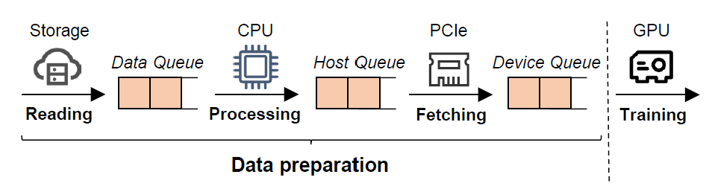
I/O Analysis
Queue-based I/O Analysis
Inter-op
Parallel Analysis
Critical Path Analysis
Intra-op
Start
I/O Analysis
Device Queue Size > 0
Y
N
CPU Analysis
Host Queue Size > 0
Y
Data fetching
N
Comp Analysis
Data Queue Size > 0
Y
Data processing
Comm Analysis
Data reading
End

Slide 23



CPU Analysis
CPU Bottleneck Causes
Inter-op
Parallel Analysis
CPU
NPU
A
A
B
C
D
Critical Path Analysis
B
C
Dispatch
D
Compilation
Execution
Intra-op
CPU bottleneck
I/O Analysis
CPU Analysis
External interference
Comp Analysis
Comm Analysis
Garage collection
Performance monitor
Environment configuration

Slide 24
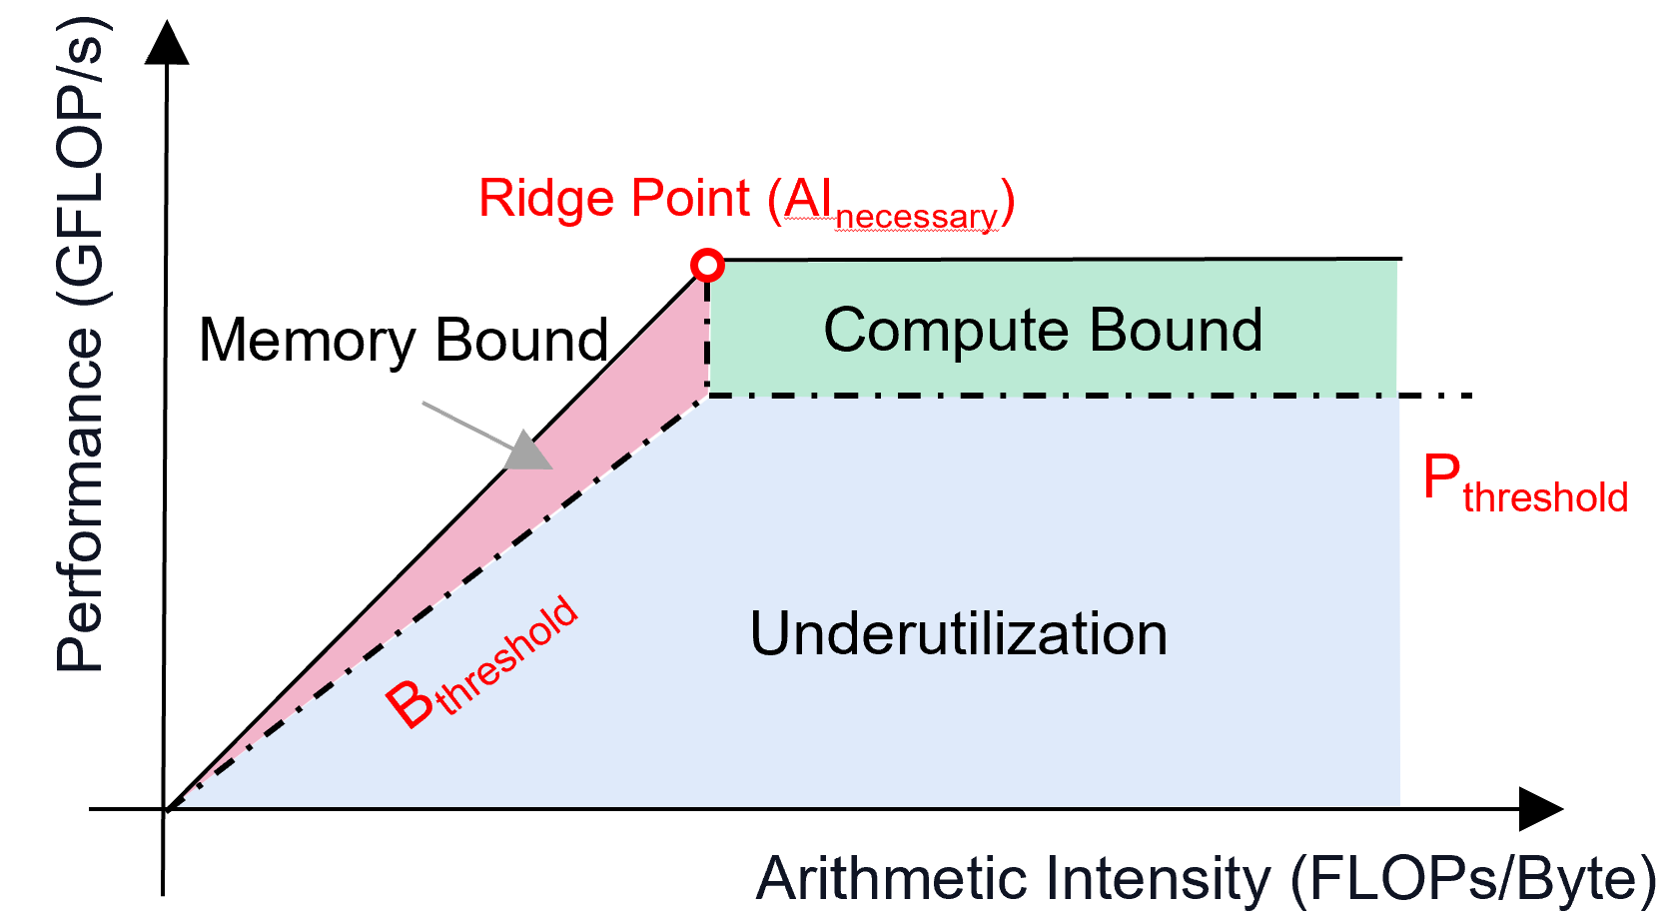
Computation Analysis
Inter-op
Computation Bottleneck
  Different compute units (AICPU, AICore Cube/Vector)
  Roofline model analysis (arithmetic, memory)
Parallel Analysis
Critical Path Analysis
Intra-op
AICPU
Eliminate or replace
I/O Analysis
CPU Analysis
NPU
Vector
Roofline model
Comp Analysis
Cube
Comm Analysis

Slide 25
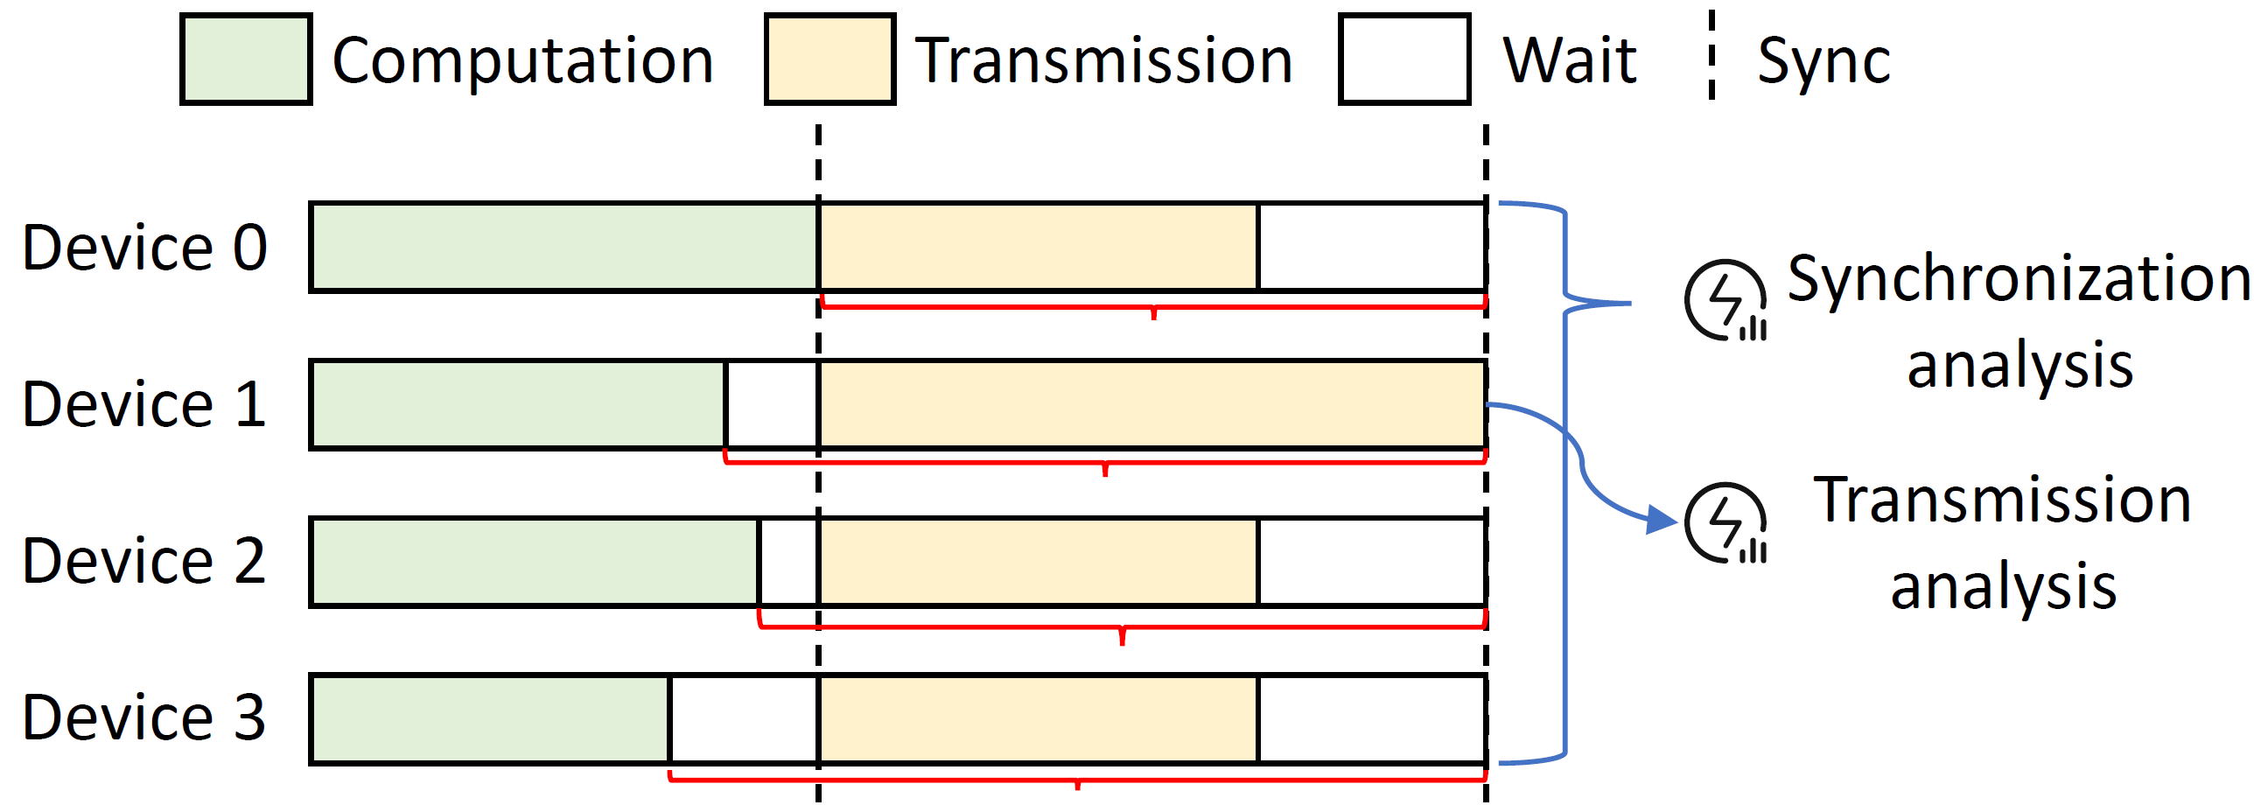
Communication Analysis
Inter-op
Synchronization + Transmission
Parallel Analysis
Critical Path Analysis
Intra-op
I/O Analysis
CPU Analysis
Synchronization
Transmission
Comp Analysis
Slow computation
Slow CPU scheduling
Bandwidth limit
Bandwidth underutilization
Comm Analysis
Detailed causes can be found in the paper.

Slide 26
Hermes System Design
1
Profiling
Analysis
Optimization
2
3
Lightweight
Monitor
Parallel
Inter-op
Cause-optimization match
CPA
Bottleneck | Cause | Optimization
… | … | …
I/O | Slow data fetching | Cache strategy
… | … | …
… | … | …
Host
Timeline
I/O
Device
Operator
CPU
Intra-op
Network
Comp
Fine-grained Profiling
Comm
Coarse-to-fine profiling
Hierarchical bottleneck analysis
Experience-guided optimization

Slide 27
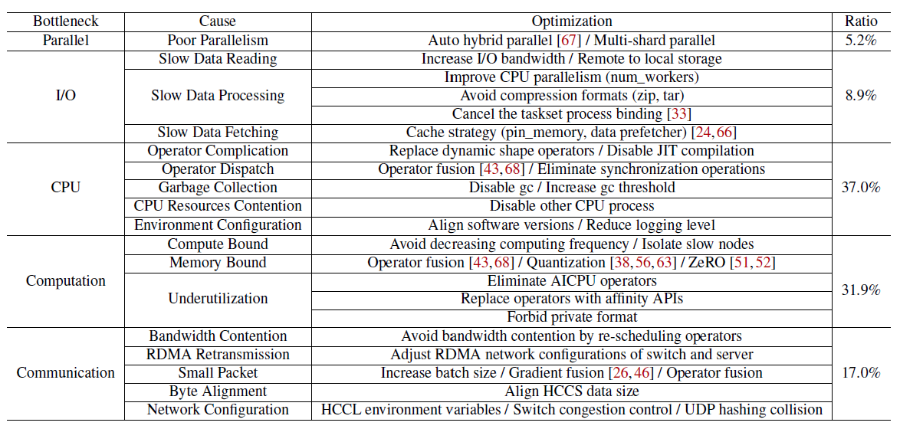
Bottleneck Cause-Optimization Match
CPU and computation bottlenecks dominate.

Slide 28
Lessons
CPU
CPU scheduling bottlenecks dominate but are often overlooked.
Computation
Underutilization dominates computation bottlenecks.
Contention between computation and communication.
Communication
Port flapping and link failures dominate network issues.
IO
Minimize remote access to alleviate I/O bottlenecks.
28

Slide 29
Outline
Introduction
Insights
System Design
Case Study
Conclusion

Slide 30
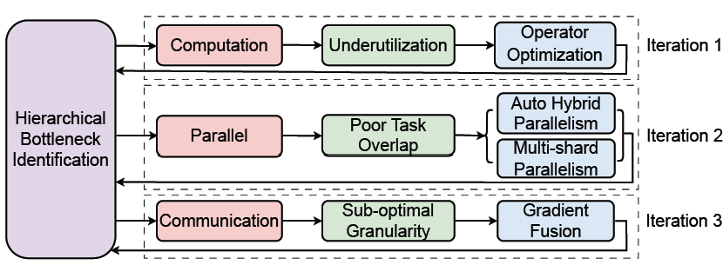
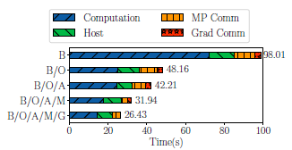
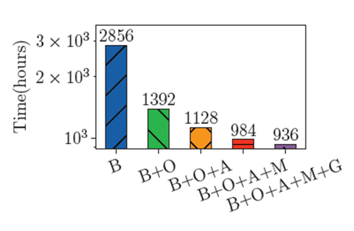
Iterative Optimization Development for PanGu-α
Device: 128 Ascend 910A
Workloads: 100B PanGu-α model training
Step time.
Overall training time.
The optimization of large model training often requires multiple iterations.
After three iterations of optimization, the total time speedup is 3.05x.

Slide 31
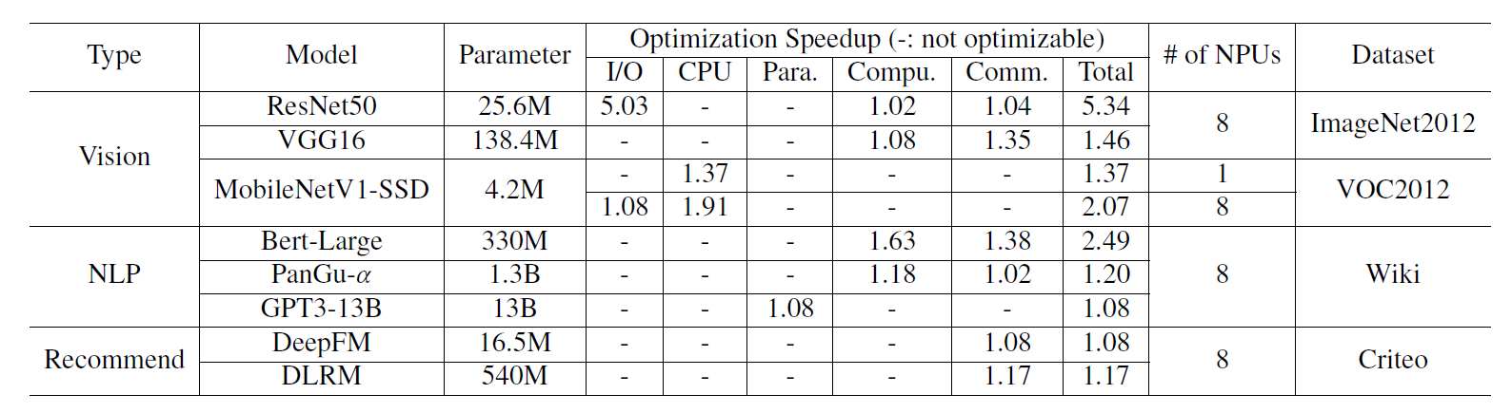
Deployment Optimization Experience
We summarize the speedups from optimization in different model deployments.
Our optimizations bring training speedups from 1.08-5.34× in vision, NLP, and recommendation models.
Detailed cases can be found in the paper.

Slide 32
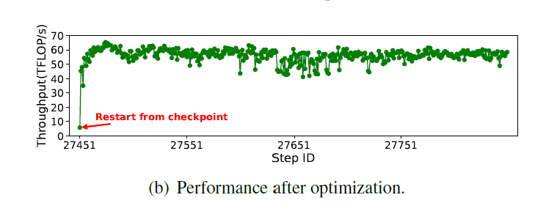
Performance Fluctuation Optimization
9k-card MoE model training
(1) Increase Python garbage collection threshold.
(2) Active garbage collection when saving checkpoints.
Training time speedup is 1.06×.
Average throughput speedup is 1.05×.

Slide 33
Outline
Introduction
Insights
System Design
Case Study
Conclusion

Slide 34
Conclusion
We propose Hermes, a systematic training optimization system with lightweight profiling, hierarchical analysis, and automated optimization guidance.
We summarize insights from 135 real-world cases and demonstrate Hermes’s effectiveness through extensive case studies.
Future Work
Expand Hermes to support emerging model training technologies like reinforce learning.
Improve Hermes’s ability to handle more complex bottlenecks and situations.
Integrate training logs and even LLM-based agents to more accurate bottleneck analysis.

Slide 35
Thanks
Q&A
wangzb@smail.nju.edu.cn
yuhangzhou@smail.nju.edu.cn

